Slide 1

NATIONAL INSTITUTE OF TECHNOLOGY - WARANGAL DEPARTMENT OF ELECTRONICS & COMMUNICATION ENGINEERING Summer Internship May-June 2024 SPECIALIZATION: Deep Learning “sEMG-based Lower Limb Activities Prediction with Various Deep Learning Models”
Presented by
- Sohith Pamu (N190830)
- Sirisha Bollineni (N190641)
Under Guidance of
Prof. Mohammad Farukh Hashmi

Slide 2
Introduction
In this project, we tackle the prediction of lower limb activity using two signals: Channel 3 ('VM') with 5681 values in millivolts (mV), and Channel 5 ('FX') with 285 values in degrees (deg). We employ deep learning techniques, including CNNs, attention blocks, residual blocks, and capsule networks, to enhance prediction accuracy. Our model, which incorporates fully connected layers, dropout layers, global pooling, batch normalization, and early stopping, achieves an impressive accuracy of 99.2%.
Key preprocessing steps include converting signals into spectrogram images, wavelet denoising, and outlier removal. The Nadam optimizer is used to balance adaptive momentum estimation and accelerated convergence. This approach has significant implications for predictive models in biomedical engineering.

Slide 3
Problem statement
Predicting lower limb activity accurately is essential for improving prosthetics, rehabilitation, and mobility aids. Traditional methods struggle with complex physiological signals, leading to suboptimal accuracy. This project aims to enhance prediction accuracy using advanced deep learning techniques, including CNNs, attention blocks, residual blocks, and capsule networks, on signals from Channel 3 ('VM') and Channel 5 ('FX').
Key challenges include handling noise and outliers, which we address through preprocessing steps like spectrogram conversion, wavelet denoising, and outlier removal. Our goal is to achieve high prediction accuracy, demonstrating the effectiveness of these combined techniques in biomedical applications.

Slide 4
Dataset Description
This dataset, posted on July 10, 2017, by Yi Zhang, Peiyang Li, Xuyang Zhu, Steven W. Su, Qing Guo, Peng Xu, and Dezhong Yao, comprises electromyography (EMG) recordings from the vastus medialis muscle of the leg in 14 healthy subjects. The data were collected during the performance of three different exercise programs: leg extension from a sitting position (sitting), leg flexion while standing (standing), and gait (walking).
For each subject, the dataset includes three distinct files corresponding to the three exercise programs. This results in a total of 42 files (14 subjects * 3 exercises per subject). Each file captures two channels of data:
The first column represents the values from Channel 3 ('VM'), while the second column represents the values from Channel 5 ('FX'). These values change across different files, reflecting the variations in muscle activity and leg angles during different exercises and across different subjects.
The original sampling rate was 50 samples per second, extrapolated to 1000 samples per second.
The dataset can be accessed via the following link: EMG Lower Limb Dataset.

Slide 5
Channel 3: 'VM'
Represents the EMG signals from the vastus medialis muscle.
Measured in millivolts (mV).
No filters applied to this channel.
Channel 5: 'FX'
Represents the angle data, capturing the movement of the leg.
Contains 285 values.
Measured in degrees (deg).
No filters applied to this channel.

Slide 6
Data Characteristics
Vastus Medialis EMG ('VM') Channel:
Captures electrical activity of the vastus medialis muscle.
The data is in millivolts, indicative of muscle activation levels.
This channel has a high density of values (5681 per exercise).
Angle ('FX') Channel:
Captures the angular movement of the leg.
The data is in degrees, representing the range of motion.
This channel has a lower density of values (285 per exercise), extrapolated from a lower original sampling rate.

Slide 7
Data Preprocessing and Spectrogram Image Generation Techniques
Removing Outliers
Outliers in the data can skew the results and negatively impact the performance of the model. The Z-score method is used for outlier removal. This statistical technique calculates the number of standard deviations a data point is from the mean of the dataset. Data points with Z-scores above a certain threshold (commonly 3) are considered outliers and are removed from the dataset. This ensures that the dataset contains only the most representative and reliable data points
Signal Denoising
Noise in the signals can introduce unwanted variability and reduce the accuracy of the model. Gaussian filtering, a type of low-pass filter, is used to denoise the signals. This filter smooths the data by averaging the values of neighboring points, effectively reducing high-frequency noise while preserving the essential features of the signal. The sigma parameter controls the extent of smoothing, with higher values resulting in more aggressive noise reduction.
Short-Time Fourier Transform (STFT)
The core of the preprocessing pipeline involves converting the time-domain signals into time-frequency domain representations using the Short-Time Fourier Transform (STFT). STFT is a mathematical technique that divides a longer time signal into shorter segments of equal length and then computes the Fourier transform for each segment. This results in a two-dimensional representation where one axis represents time, the other represents frequency, and the intensity of colors represents the magnitude of the signal at each frequency and time point. This transformation is essential for capturing both the temporal and spectral characteristics of the EMG and angle signals, providing a more informative input for the deep learning model.

Slide 8
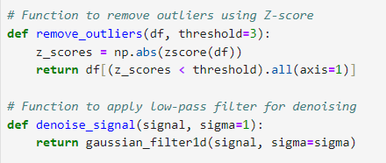
Code snippet

Slide 9
Sampling and Image Creation
To ensure the model receives sufficient and varied training data, the signals are segmented into smaller, overlapping samples. Each sample is transformed into an STFT spectrogram image. This involves:
Segmentation: The data is divided into samples of a fixed size (750 data points in this case). Multiple samples are generated from each signal by sliding a window across the entire length of the signal, creating overlapping segments.
STFT Computation: For each sample, STFT is applied to both 'EMG' and 'Angle' signals. This generates two spectrograms per sample.
Image Generation: The spectrograms of 'EMG' and 'Angle' are plotted side by side to create a single combined image. Consistent frequency and time axis limits are maintained across all images to ensure uniformity. The color intensity in these images corresponds to the magnitude of the STFT, with careful scaling to capture the full range of magnitudes across different samples.

Slide 10
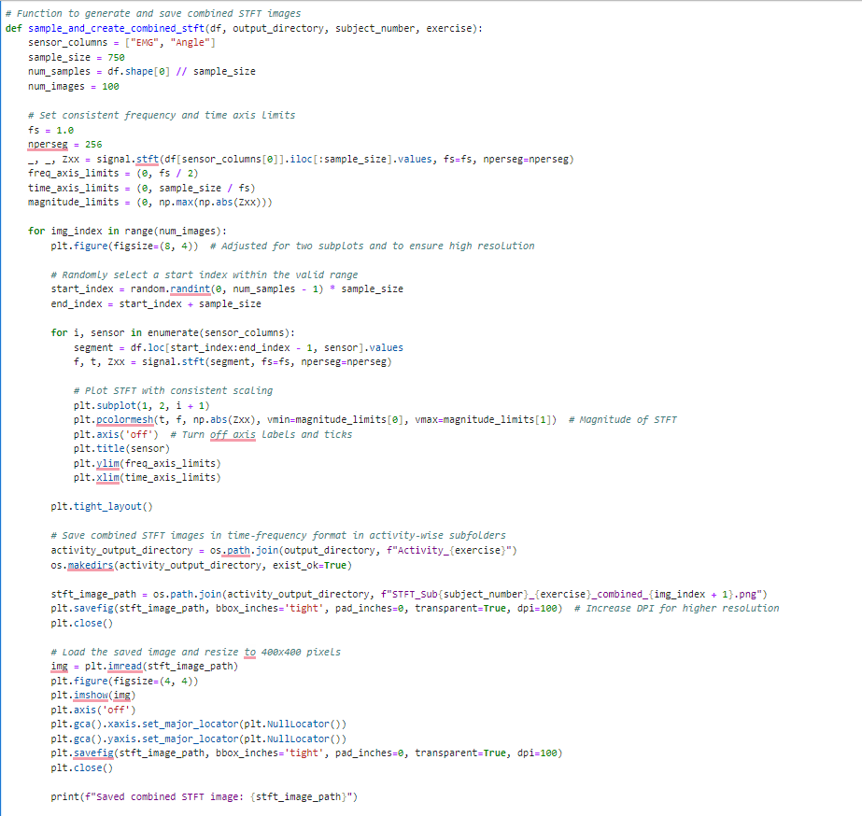

Slide 11
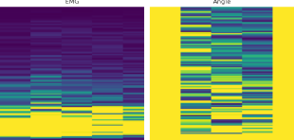
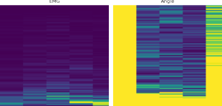
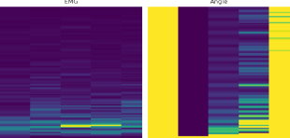
Spectogram Images
Figure 1 Activity-Gait
Figure 2 Activity-Sitting
Figure 3 Activity-Standing

Slide 12
Data Loading and Augmentation Process for Training the Model
To efficiently train a deep learning model on a large dataset of spectrogram images, we employ data generators to load and preprocess the data in batches. This approach optimizes memory usage and speeds up the training process. The following steps outline the process of preparing the data for model training, including data scaling, batching, and splitting into training and test sets.
Data Scaling and Normalization
The first step involves scaling the pixel values of the images. Spectrogram images typically have pixel values ranging from 0 to 255. To normalize these values, we use an instance of ImageDataGenerator with a rescale parameter set to 1./255. This normalization step ensures that the pixel values are within the range [0, 1], which is crucial for the stability and performance of many deep learning models.
Python code
datagen = ImageDataGenerator(rescale=1./255)

Slide 13
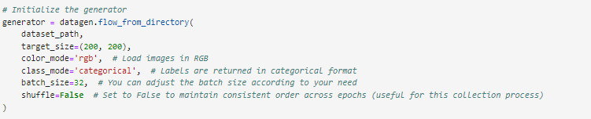
Data Loading with ImageDataGenerator
The ImageDataGenerator is used to create an efficient pipeline for loading images from the directory structure. This generator reads images in batches directly from the disk, reducing memory usage by avoiding loading the entire dataset into memory at once.

Slide 14
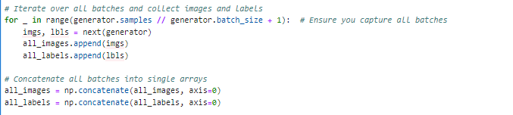
Collecting All Images and Labels
To prepare the data for splitting into training and test sets, all images and labels are collected from the generator. This step involves iterating over all batches produced by the generator and concatenating them into single arrays.

Slide 15
Splitting Data into Training and Test Sets
To evaluate the model's performance, the dataset is split into training and test sets using train_test_split from sklearn.model_selection. This function randomly partitions the dataset, ensuring that a portion (20% in this case) is set aside for testing.

Slide 16
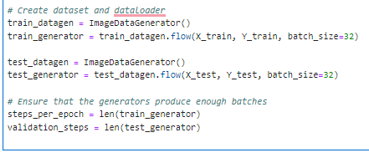
Creating Data Generators for Training and Testing
New instances of ImageDataGenerator are created for training and testing to provide batches of data during model training. These generators yield batches of images and labels indefinitely, which is useful for training in multiple epochs.

Slide 17
Technologies and Techniques Used in Model Building
TensorFlow and Keras
TensorFlow: TensorFlow is an open-source deep learning framework developed by Google for building and training machine learning models.
Keras: Keras is an API designed for human beings, not machines. It puts user experience front and center. Keras is a high-level neural networks API, capable of running on top of TensorFlow.
Layers and Techniques
Convolutional Layers (Conv2D):
Used for spatial convolution over images.
Applies a specified number of filters to the image, each filter performing convolution to produce a set of activations.
Batch Normalization (BatchNormalization):
Normalizes the activations of a previous layer at each batch, i.e., applies a transformation that maintains the mean activation close to 0 and the activation standard deviation close to 1.
MaxPooling2D (MaxPooling2D):
Downsamples the input representation by taking the maximum value over the window defined by pool_size for each dimension along the features axis.

Slide 18
Dropout (Dropout):
Regularization technique where a proportion of nodes in the layer are randomly ignored (dropped out) during training.
Helps prevent overfitting by forcing the model to learn redundant representations.
Residual Blocks:
Residual Connection: A skip connection that allows gradients to flow through a shortcut, alleviating the vanishing gradient problem.
Residual Learning: Learning residual functions with reference to the layer inputs, which makes training deeper networks easier.
Attention Mechanism:
Adds attention weights to the feature map to highlight important regions.
Consists of Conv2D layers with ReLU and Sigmoid activations to compute attention weights.
Capsule Layer (Capsule):
A group of neurons whose activity vector represents the instantiation parameters of a specific type of entity.
Uses a custom Capsule layer implementation with dynamic routing for better representation of hierarchical relationships within data.
Global Average Pooling (GlobalAveragePooling2D):
Computes the average of all values in the feature maps across spatial dimensions.
Reduces each feature map to a single value, preserving spatial information.
Custom Activation Functions:
Squash Activation (squash): Scales input vectors along their length to a value less than 1.
Softmax Activation (softmax): Converts logits to probabilities, ensuring they sum to 1 across classes.

Slide 19
Optimizer
Nadam Optimizer (Nadam):
Adam optimizer variant that incorporates Nesterov momentum.
Adaptive learning rate optimization algorithm that combines momentum techniques with adaptive learning rates.
Metrics
Custom F1 Score Metric (F1Score):
Calculates the F1 score, a measure of a model's accuracy, combining precision and recall.
Custom implementation using TensorFlow operations for binary or multi-class classification tasks.
Callbacks
EarlyStopping (EarlyStopping):
Monitors a specified metric (e.g., validation loss) and stops training when it stops improving, thereby preventing overfitting.
ReduceLROnPlateau (ReduceLROnPlateau):
Reduces the learning rate when a monitored metric (e.g., validation loss) has stopped improving.
Helps in fine-tuning the model during training.
This model incorporates advanced techniques like residual connections, attention mechanisms, and capsule networks to improve feature representation and capture hierarchical relationships in spectrogram images. Custom metrics and optimizers enhance model evaluation and training efficiency, while callbacks ensure effective training and prevent overfitting. Overall, this setup demonstrates a sophisticated approach to deep learning model building using TensorFlow and Keras for image classification tasks

Slide 20
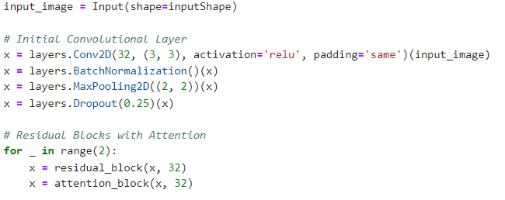
Model Architecture
This describes the architecture of the deep learning model designed for spectrogram image classification. The model integrates several advanced techniques, including residual blocks, attention mechanisms, capsule layers, and regularization strategies to achieve high performance and robustness.
Input Layer
Input Shape: (200, 200, 3)
The model expects input images of size 200x200 with 3 color channels.
Initial Convolutional Layer
Layer Type: Convolutional Layer
Number of Filters: 32
Filter Size: (3, 3)
Activation Function: ReLU
Padding: Same
Additional Layers:
Batch Normalization: Normalizes the activations of the previous layer to speed up training.
MaxPooling: (2, 2) - Reduces the spatial dimensions of the feature maps.
Dropout: 0.25 - Randomly drops 25% of the neurons to prevent overfitting.

Slide 21
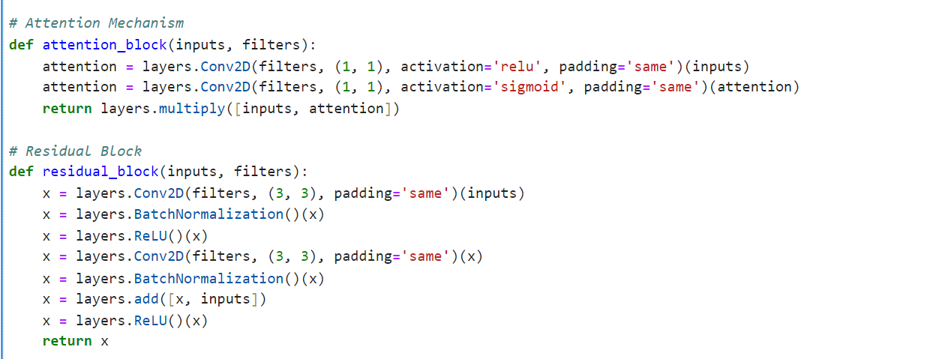
Residual Blocks with Attention
The model includes multiple residual blocks with integrated attention mechanisms to improve feature extraction and model performance.
Number of Residual Blocks per Group: 2
Residual Block:
Convolutional Layers: 2 convolutional layers with the same number of filters as the input.
Batch Normalization: Applied after each convolutional layer.
ReLU Activation: Applied after the first convolutional layer and at the end of the residual block.
Skip Connection: Adds the input of the block to the output of the second convolutional layer.
Attention Block:
Conv2D Layers: Two (1, 1) convolutional layers, the first with ReLU activation and the second with Sigmoid activation.
Element-wise Multiplication: Multiplies the output of the attention block with its input to emphasize important features.

Slide 22
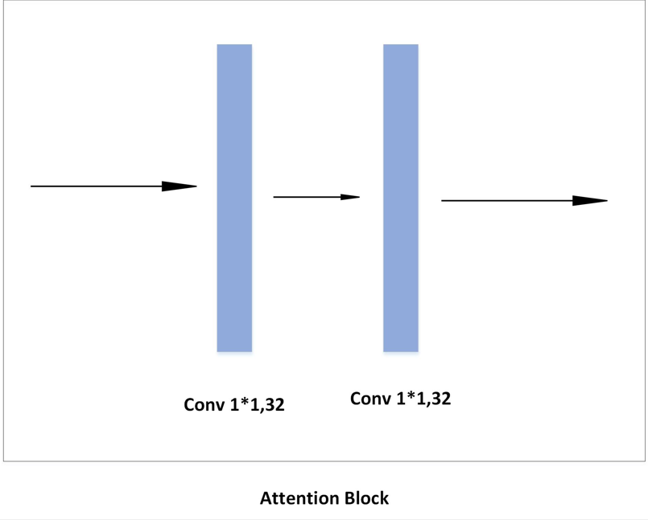
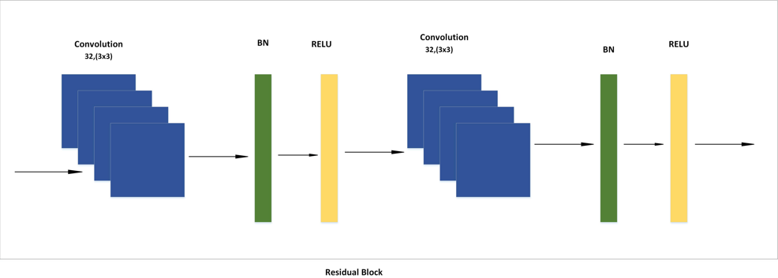

Slide 23
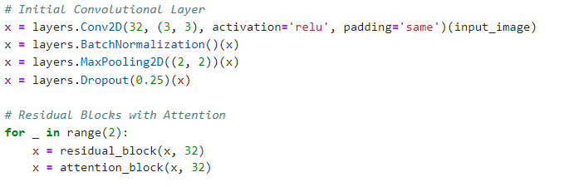
First Group
Filters: 32
Layers:
2 Residual Blocks with Attention
Convolutional Layer: 64 filters, (3, 3), ReLU, same padding
Batch Normalization
MaxPooling: (2, 2)
Dropout: 0.25

Slide 24
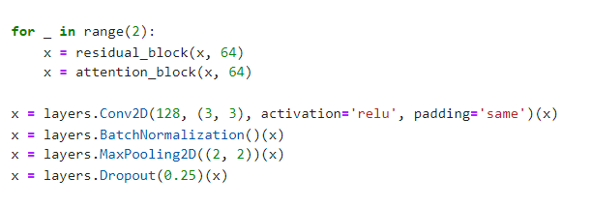
Second Group
Filters: 64
Layers:
2 Residual Blocks with Attention
Convolutional Layer: 128 filters, (3, 3), ReLU, same padding
Batch Normalization
MaxPooling: (2, 2)
Dropout: 0.25

Slide 25
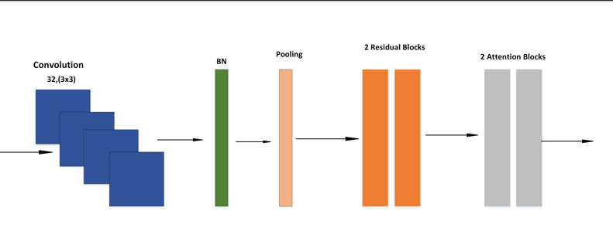

Slide 26
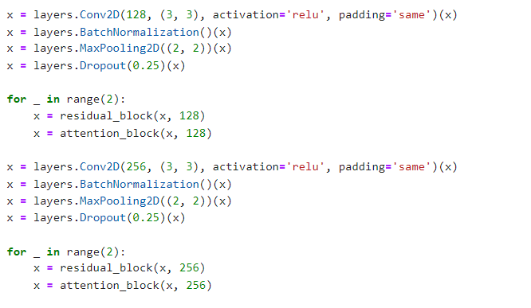
Third Group & Fourth Group
Filters: 128
Layers:
2 Residual Blocks with Attention
Convolutional Layer: 256 filters, (3, 3), ReLU, same padding
Batch Normalization
MaxPooling: (2, 2)
Dropout: 0.25
Filters: 256
Layers:
2 Residual Blocks with Attention

Slide 27
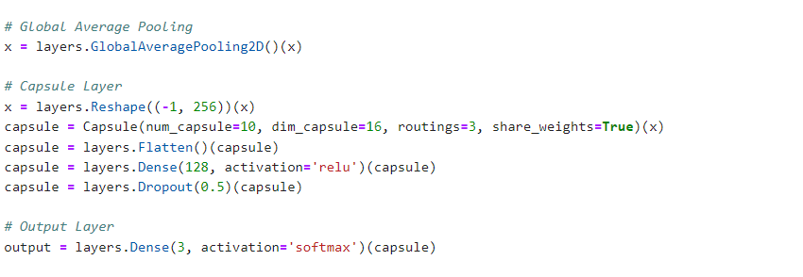
Global Average Pooling
Reduces each feature map to a single value by computing the average of all values in the feature map, significantly reducing the number of parameters and helping to prevent overfitting.
Capsule Layer
Reshape: Reshapes the output from global average pooling to be compatible with the capsule layer.
Capsule Layer:
Number of Capsules: 10
Dimension of Each Capsule: 16
Routings: 3
Share Weights: True
Flatten: Flattens the output from the capsule layer to prepare it for the dense layers.
Fully Connected Layer
Dense Layer: 128 neurons, ReLU activation
Dropout: 0.5 - Randomly drops 50% of the neurons to prevent overfitting.
Output Layer
Dense Layer: 3 neurons, Softmax activation
The output layer produces a probability distribution over the 3 classes

Slide 28
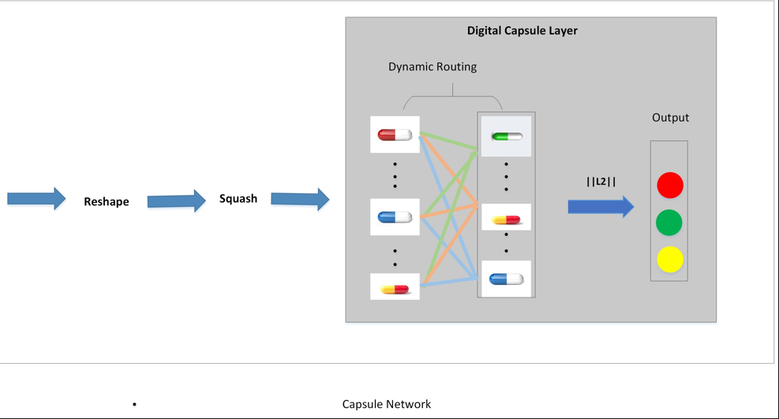
Capsule Layer

Slide 29

Model Compilation
Loss Function: Categorical Crossentropy - Suitable for multi-class classification problems.
Optimizer: Nadam (Nesterov-accelerated Adaptive Moment Estimation) - Combines the benefits of Nesterov momentum and Adam optimizer.
Metrics:
Accuracy: Measures the percentage of correct predictions.
Custom F1 Score: Combines precision and recall to give a single performance metric, particularly useful for imbalanced datasets.

Slide 30
Evaluation Metrics & Results
Precision
Precision quantifies the number of true positive predictions made by the model over the total number of positive predictions (both true positives and false positives). It measures the accuracy of positive predictions.
Macro Precision: Computes precision for each class and takes the unweighted average.
Weighted Precision: Computes precision for each class, weighted by the number of true instances for each class.
Recall
Recall calculates the ratio of true positive predictions to the sum of true positives and false negatives. It measures the model's ability to correctly identify all positive instances.
Macro Recall: Calculates recall for each class and takes the unweighted average.
Weighted Recall: Computes recall for each class, weighted by the number of true instances for each class.

Slide 31
F1-Score
The F1-score is the harmonic mean of precision and recall. It provides a single metric that balances both precision and recall, offering a more comprehensive view of model performance.
Macro F1-Score: Computes the F1-score for each class and takes the unweighted average.
Weighted F1-Score: Calculates the F1-score for each class, weighted by the number of true instances for each class.
Accuracy
Accuracy measures the proportion of correctly predicted instances out of the total instances in the dataset. It is a straightforward metric but can be misleading in imbalanced datasets.
Classification Report
The classification report provides a detailed summary of evaluation metrics for each class in the dataset. It includes precision, recall, and F1-score for each class, along with support (the number of true instances for each class).
Confusion Matrix
A confusion matrix is a table that visualizes the performance of a classification model. It shows the number of true positive, true negative, false positive, and false negative predictions made by the model across all classes.

Slide 32
Interpretation of Results
Precision, Recall, and F1-Score: In the provided example, the precision, recall, and F1-score are all high across the classes ('gait', 'standing', 'sitting'), indicating that the model performs well in correctly identifying each class.
Support: This refers to the number of actual occurrences of each class in the dataset.
Accuracy: The overall accuracy of 99% indicates that the model correctly predicts the class label for 99% of instances in the test set.
Macro and Weighted Averages: Macro averages give equal weight to each class, while weighted averages consider the support (number of instances) for each class, providing a more realistic measure of performance in imbalanced datasets

Slide 33
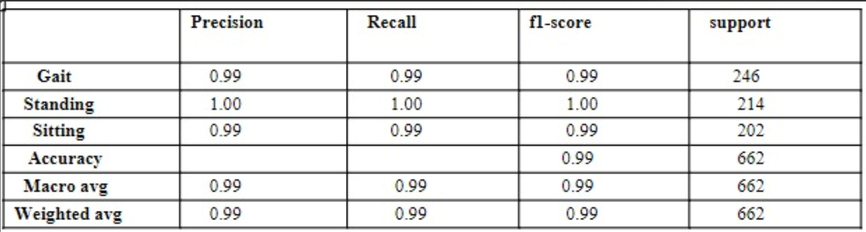
Classification Report
The classification report for the model is as follows:

Slide 34
Gait: Precision = 0.99, Recall = 0.99, F1-score = 0.99
Standing: Precision = 1.00, Recall = 1.00, F1-score = 1.00
Sitting: Precision = 0.99, Recall = 0.99, F1-score = 0.99
Overall Accuracy: 0.99
Macro Average: Precision = 0.99, Recall = 0.99, F1-score = 0.99
Weighted Average: Precision = 0.99, Recall = 0.99, F1-score = 0.99

Slide 35
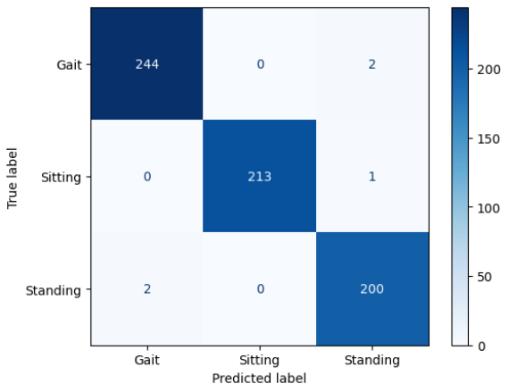
ConfusionMatrix

Slide 36
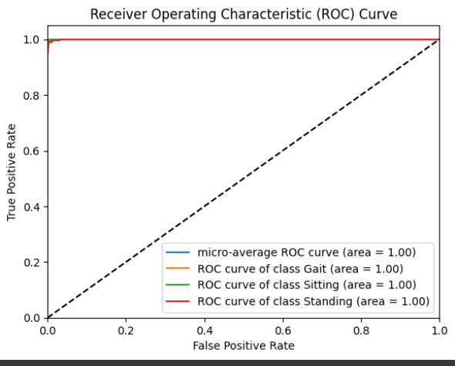

Slide 37
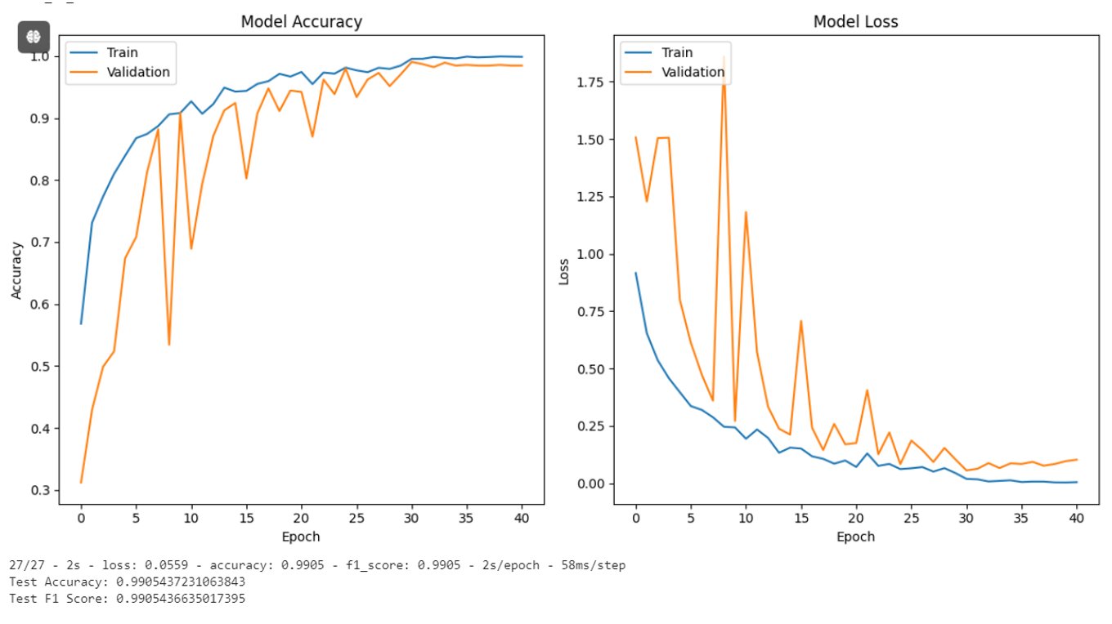
Training Graph

Slide 38
Conclustion
In this research, we introduced CARCNet, an innovative deep learning architecture designed to accurately predict lower limb activities using raw EMG signals. By integrating Convolutional Neural Networks (CNNs), attention mechanisms, residual blocks, and Capsule Networks (CapsNet), CARCNet effectively enhances feature extraction and classification accuracy. The proposed model leverages the strengths of CNNs in local feature extraction and CapsNet in capturing spatial relationships between features, offering a robust solution for lower limb activity prediction.
Our approach includes converting EMG signals into time-domain frequency images through segmentation and synchrosqueezing transforms, providing a rich representation for deep learning models. Extensive experimentation on publicly available datasets demonstrated CARCNet's superior performance over conventional deep learning techniques, highlighting its adaptability and efficacy in various computer vision tasks.
The success of CARCNet underscores its potential for developing advanced prosthetics and exoskeletons controlled by the nervous system. The model's adaptability to diverse datasets, combined with fine-tuning of hyperparameters and augmentation strategies, further improved its performance and convergence rates. Overall, CARCNet represents a significant advancement in deep learning architectures for biomedical applications, paving the way for future research and practical implementations in this field.

Slide 39
References
M. S. Al-Quraishi, I. Elamvazuthi, T. B. Tang, M. Al-Qurishi, S. Parasuraman and A. Borboni, "Multimodal Fusion Approach Based on EEG and EMG Signals for Lower Limb Movement Recognition," in IEEE Sensors Journal, vol. 21, no. 24, pp. 27640- 27650, 15 Dec.15, 2021, doi: 10.1109/JSEN.2021.3119074
Guo, Xu Dong, et al. “Adaptive Random Forest for Gait Prediction in Lower Limb Exoskeleton.” Journal of Biomimetics, Biomaterials and Biomedical Engineering, vol. 64, Trans Tech Publications, Ltd., 10 Apr. 2024, pp. 55–67. Crossref, doi:10.4028/p-q2hybx
Güler, N. F., and Koçer, S. 2005. Classification of EMG signals using PCA and FFT. J. Med. Syst. 29, 3, (2005), 241- 250
Subasi, A. 2013. Classification of EMG signals using PSO optimized SVM for diagnosis of neuromuscular disorders. Comput Biol Med. 43, 5, (2013), 576-586
Y. Li, F. Gao, X. Zheng, and H. Gan. 2017. Gait Recognition Using GA-SVM Method Based on Electromyography Signal. In Proceedings of the International Conference on Intelligent Robotics and Applications (Wuhan, China, August 15-18, 2017). 313- 322
.W. Zhong, Y. Zhang, P. Fu, W. Xiong and M. Zhang, "A Spatio-Temporal Graph Convolutional Network for Gesture Recognition from High-Density Electromyography," 2023 29th International Conference on Mechatronics and Machine Vision in Practice (M2VIP), Queenstown, New Zealand, 2023, pp. 1-6, doi: 10.1109/M2VIP58386.2023.10413402
Y. Lecun, L. Bottou, Y. Bengio and P. Haffner, "Gradient-based learning applied to document recognition," in Proceedings of the IEEE, vol. 86, no. 11, pp. 2278-2324, Nov. 1998, doi: 10.1109/5.726791
Sabour, S., Frosst, N. and Hinton, G.E., 2017. Dynamic routing between capsules. Advances in neural information processing systems, 30
Barnett, V., & Lewis, T. (1994). Outliers in Statistical Data. Wiley.
Donoho, D. L. (1995). De-noising by soft-thresholding. IEEE Transactions on Information Theory, 41(3), 613-627
Tseng, C.-H., et al. (2020). EMG Signal Classification for Human-Machine Interface: Performance, Challenges, and Future Directions. Biomedical Signal Processing and Control, 57, 101838
. Hinton, G. E., Krizhevsky, A., & Wang, S. D. (2011). Transforming auto-encoders. In International Conference on Artificial Neural Networks (pp. 44-51). Springer, Berlin, Heidelberg.

Slide 40
Thank you..

